Slide 1
IBM – Applied Data Science Capstone CAPSTONE Project – Final Report The Battle of Neighbourhoods By Lakshmi Sajja

Slide 2
Neighbourhood selection to start a Grocery business
Neighborhood plays a vital role for a successful business. Budding entrepreneurs thrive to find a safe and viable neighborhood to start a business.
Crimes like break into commercial property to for theft are on rise and people thinking to enter into similar business should bear in mind criminal activity of the neighborhood before finalizing a location. We look to address this issue by analyzing the crime data of Vancouver City and finding the safest borough and a neighborhood with in the borough.
Neighborhood in safest Borough with top common venue as Grocery store indicate people choice and need of grocery store

Slide 3
Data acquisition and cleaning
Type of crime, recorded time and coordinates of Neighborhood in Vancouver from Kaggle data set.
Neighborhood and Borough from Wikipedia.
Top venues in each Neighborhood from Foursquare API.
Raw data set from Kaggle has close to 600,000+ rows which GitHub couldn’t accommodate. Recent crime i.e. in 2018 is considered for data set.
Fields such as month and hour in which the crime took place has been dropped because they were not in the scope of the problem.

Slide 4
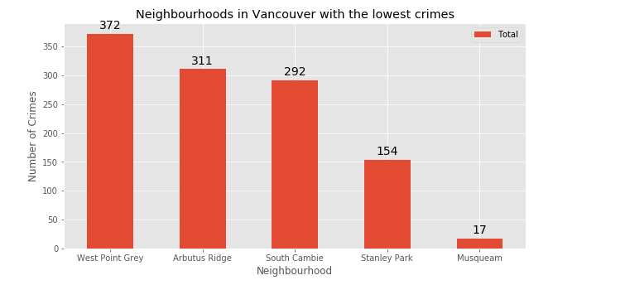
Methodology – Exploratory data analysis
Visualise the crime repots in different Vancouver boroughs to identity the safest borough and normalise the neighbourhoods of that borough.

Slide 5
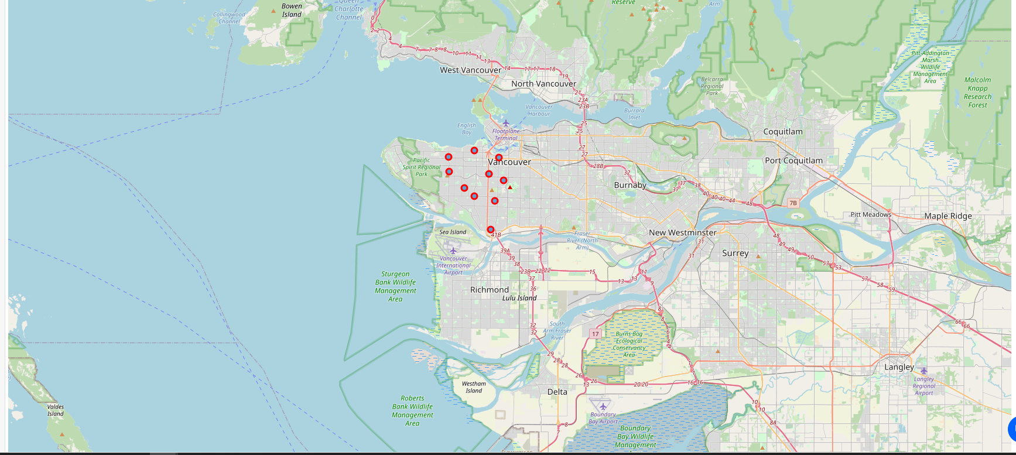
Methodology – Exploratory data analysis
Neighbourhoods plot safest borough – West side

Slide 6
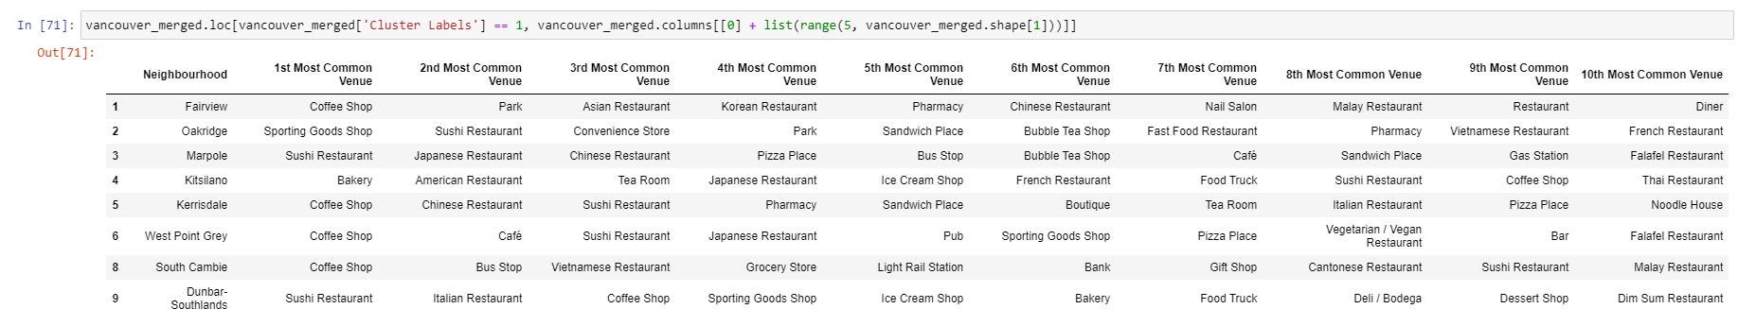
Data Modelling
Identified top venues in West side borough using Foursquare API. Applies k-means clustering on neighbourhoods based on top venues.
Cluster 1:
Cluster 2:
Cluster 3:

Slide 7
Conclusion and Future Directions
Built a useful model to find safest Borough and a Neighbourhood to start a business.
Accuracy of the model has a room for improvement.
Future scope of the project is consider population of each neighbourhood which will be an important factor on decision making.

